Slide 1
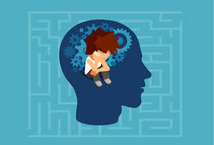
My Mental Health

Slide 2
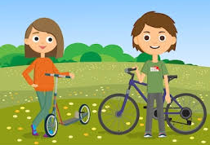
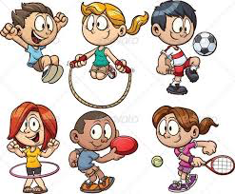
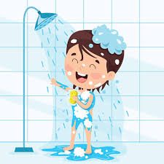
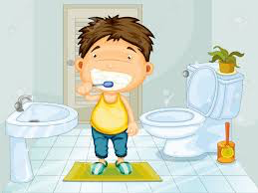
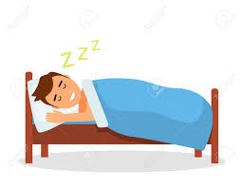
Keeping Healthy
My physical health is very important to me.
I can keep myself physically healthy by…..
Eating a balanced diet
Getting fresh air and exercising regularly
Having good personal hygiene
Getting the right amount of sleep

Slide 3
To keep myself physically healthy I……
Notes:
Each student to complete this page with information about their sleep pattern, personal hygiene routines, diet and exercise routines.

Slide 4
When I am physically healthy I feel fit and strong.
I can take part in my daily activities – on my own or with my family or my friends.
Being physically healthy helps me to feel calm and happy. This feels good.

Slide 5
Keeping Healthy
My mental health is also very important to me.
My mental health is about my feelings, my thoughts, my emotions and my mood.
I have lots of small feelings that come and go everyday. They don’t stop me from doing what I want to do.
worried
happy
confused
sad
cross

Slide 6
Sometimes I might have a big feeling that goes on for a very long time.
This big feeling stops me from doing what I want to be doing in life.
This big feeling affects my mental health.
depressed
fearful
anxious
angry
stressed

Slide 7
What to do when I have a big thought or feeling?
I can talk to someone I trust.
I can write or draw a picture to show what I am thinking or feeling.
I have something important I want to speak to you about….
I’ve been having a really hard time lately…..
Please help me, I’m really struggling…….
“My head feels empty – I want to hide away on my own forever”
“I feel like there is a hammer pounding inside my head – I want to punch the wall really hard”

Slide 8
When I am having Big Thoughts and Feelings I can…………
Notes:
Each student to complete this page with the strategies/techniques that help them to feel calm and relaxed e.g. deep pressure massage, going for a run, having a bath, quiet time on own, talking to key worker etc.

Slide 9
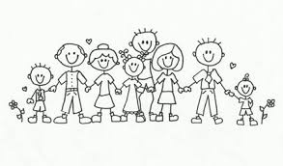
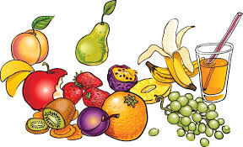
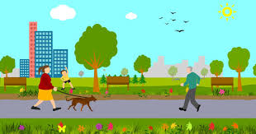
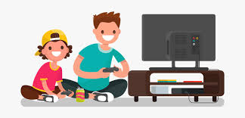
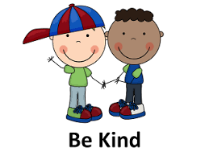
Looking after my mental health
It is as important to look after my mental health as my physical health.
I can look after my mental health, and feel good by………
Spending time with my family and friends Eating well
Getting lots of rest and relaxation time Spending time outdoors
Spending time doing things that interest me Doing little things to help others

Slide 10
To look after my mental health I……
Notes:
Each student to complete this page with information about their social time with family/friends, their interests, how they relax, what they do to help others and how they spend time outdoors in the natural world.

Slide 11
When I am mentally healthy I feel fit and strong.
I can take part in my daily activities – on my own or with my family or my friends.
Being mentally healthy means that I can cope with life and make the most out of every day.
Being mentally healthy helps me to feel calm and happy. This feels good.

